Slide 1
MUSIC RECOMMENDER SYSTEM
TEAM 3
DEVESH KANDPAL
PRIYESH KAUSHIK
ANINDITA CHAKRABORTI

Slide 2
INTRODUCTION
For this project, we experimented, designed and implemented a song recommendation system.
Our primary aim was to find correlations between users and between songs to provide recommendation to users with songs that they would prefer to listen to.

Slide 3
GOALS
Build a reactive web application that interacts with a Big Data system.
Explore the applications of Machine Learning using Apache Spark which will be used for generating the recommendations.
Build a reactive scalable web application using Play Framework and Akka.

Slide 4
FRAMEWORKS/ TECHNOLOGIES USED
Scala
Apache Spark (Spark SQL, Spark MLlib and Spark Streaming)
Play Framework
Apache Kafka
Akka Actors
MongoDB
Angular2
NodeJS

Slide 5
DATASET AND EXPLANATION
Million Song Unique Tracks Dataset This dataset consists of Track ID, Song ID, Artist ID and Song Name. Sample data: TRAAAAW128F429D538<SEP>SOMZWCG12A8C13C480<SEP>Casual<SEP>I Didn't Mean To
Echo Nest dataset This dataset consists of information about User (user_id), Song Information (track_id) and the number of times the song has been played. Sample data: b80344d063b5ccb3212f76538f3d9e43d87dca9e TRAAAAW128F429D538 1

Slide 6
DATASET AND EXPLANATION - Contd
MusixMatch dataset We divided this dataset into two parts: - The first part is basically a dictionary which has two columns: words used in the song and their index, which is their unique identifier. Sample data: 0:is,1:of,2:your,3:that,4:do,5:on,6:are,7:we,8:am,9:will
The second part consists of Song ID (MSD), TrackId (MusicXMatch) , Word ID and Count. Sample data: TRAAAED128E0783FAB,2516445,1:28,2:15,3:2,4:12,5:22,6:2,7:2,8:4,9:2,10:1,11:20,12:3,13:1,15:7,16:2,17:1,18:2,20:8,21:13,23:6,25:4,26:3,27:11,28:9,30:4,31:1,34:1,35:3,36:1,39:6

Slide 7
FEATURE VECTOR
KMeans Artist Recommendation eg:
(“b80344d063b5ccb3212f76538f3d9e43d87dca9e” -> [“Iron Maiden”, “Metallica”, “Coldplay”]) => (“b80344d063b5ccb3212f76538f3d9e43d87dca9e” -> [12.0, 35.0, 87.0]), where 12.0, 35.0 and 87.0 are the system generated artistId used as features
ALS Rating eg :
Tuple3(“b80344d063b5ccb3212f76538f3d9e43d87dca9e”, “Iron Maiden”, 22) => Rating(11, 12, 22), where 11 is the UserId (b80344d063b5ccb3212f76538f3d9e43d87dca9e), 12 is the artistId and 22 is the count of times this artist is heard by this user.
KMeans Lyrics Recommendation eg :
(TRAAAAW128F429D538 -> [“happy”, “excited”, “having”, “should”, “foolishly”, “mysteriously”]) =>
(TRAAAAW128F429D538 => [11.0, 23.0, 6.0, 56.0, 61.0, 78.0]), where [11.0, 23.0, 6.0, 56.0, 61.0, 78.0] are the wordIds in the word dictionary dataset used as features.

Slide 8
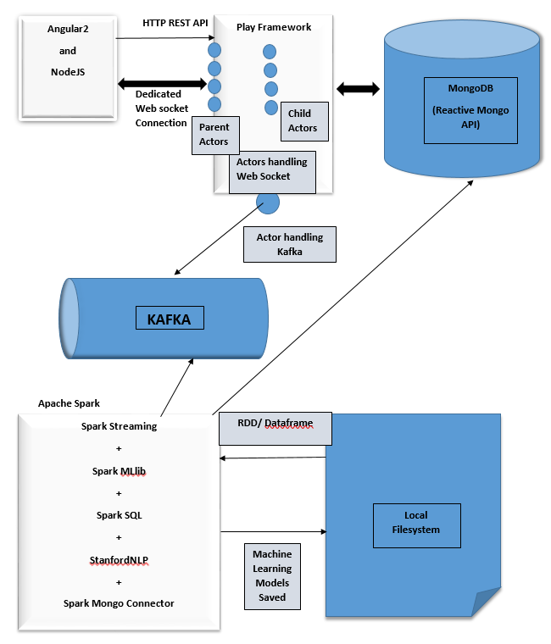
ARCHITECTURE

Slide 9
DETAILS ABOUT THE ARCHITECTURE
Post ingestion and transformation of the dataset, the computed models are saved in the local Filesystem.
Spark Streaming is used to poll Kafka for any new user request.
For real-time recommendations, dedicated web-sockets are opened on Play framework. Each request is handled by a parent actor which delegates the work to a child actor which eventually forwards the message to a Kafka Actor for sending and receiving messages to/from Kafka topics
Reactive Mongo is used for non-blocking operations with MongoDB.
rxJS by ReactiveX.IO is used at client side (Angular2) for non-blocking service calls to services exposed by Node.JS

Slide 10
USE CASES
Cold start user – When a new user uses the system, recommend artists to this new user based on their artist preferences.
Recommend artist for existing users.
Recommend artists from users who listen to the current artist you are listening to.
Recommend songs based on similarity in lyrics.

Slide 11
METHODOLOGY USED IN USE CASES

Slide 12
RECOMMENDATION FOR NEW USER
Cold start user:
When a new user uses the recommendation system for the first time, they are given a list of artists that they can choose their favorite artists from. Based on their selection, they are placed in a pre-computed K-means cluster that clusters users based on their artist preferences.
Next, we load the ALS model for this cluster and use ALS to recommend users for each of the artists sent by the cold start user. This is followed by using ALS to recommend artists for these users. These artists are then sorted and filtered and sent as recommendations to the new user.

Slide 13
RECOMMENDATIONS FOR EXISTING USERS
Recommend artist for existing users - Get the cluster Id from the database, pull out the respective ALS model and recommend artist for this user using an ALS api.
Recommend artists from users who listen to the current artist you are listening to - From the loaded ALS model, recommend users for this artist followed by recommending artists for these users. - These artists are then sorted and filtered and sent as recommendations to the user.

Slide 14
LYRICS BASED RECOMMENDATION
Recommend songs based on similarity in lyrics
By making use of StanfordNLP, songs are pre-clustered using Spark MlLib’s Kmeans clustering, based on Parts of Speech (Adj, Verb & Adverb).
For the current user session all the songs that the user has listened to, they are captured. For these songs, vectors (relevant parts of speech such as adjective, adverb and verb) are identified using StanfordNLP.
These vectors are then used to place the current user in one of the pre-computed KMeans cluster.
The top 10 songs with the smallest Euclidean distance to the center of this cluster are selected and sent as recommendations to the user.

Slide 15
ACCEPTANCE CRITERIA AND RESULTS
We should be able to generate relevant real time recommendations on UI screen within 2 minutes. (Recommendations are populated on the UI Screen within 5 seconds.)
We should be able to serve this application in a 2 or more users environment without having any interference between the users. (Successful in multiuser environment without cross-talk.)
We would be showcasing approximately 70% precision and accuracy of our recommendation engine by comparing recommendations by Last.fm. (Showcased relevant recommendations)

Slide 16
REPOSITORY DETAILS
Our project is hosted on GitHub.
Repository URL: https://github.com/chakrabortian/realtimemusicrecommendationapp

Slide 17
THANK YOU!

